Slide 1



Data Bootcamp Final Project Presentation
Template
Factors that impact life expectancy and mortality rate
By Sophia Brotherson

Slide 2
About me
I am a creative individual who has a degree in Hair and Theatrical Makeup. I have previously completed the XR Bootcamp with Niyo Enterprise to further investigate my creative side with in technology department.
College : Fine Art
University: Hair and Theatrical Makeup
Experience: Customer service/ Administration/ Beauty Ambassador

Slide 3
Why did you choose to learn Data Analytics, and what role would you like to work in following what you've learned?
I am fascinated with the idea of using data manipulation to discover current issues but also the cause, which can have a huge impact on the growth of a business or even an individuals life style.
Being able to help resolve issues promptly is a valuable skill that will save a lot of time and money overall.
This also has broadened my knowledge further as I am learning about different industries and how they work to navigate current issues.
As I am currently working for a healthcare company I would ideally like to work as a data analyst in health care.

Slide 4
About your project
The objective of my project is to discover main factors and causes that has led to a decline in life expectancy and the cause of high mortality rates: (Deaths).
The main focus was to determine which country had the highest amount of deaths specifically adult mortality, as the highest percentage of deaths where adults.
To determine the main cause of this, I compared the country with the least amount of deaths against the country with the most amount of deaths, which clarified how life expectancy and mortality rate can continue to improve in the future.

Slide 5
How did you apply what you have learnt in the Bootcamp?
Excel: For data cleansing, via removing duplicates, filling in blanks and formatting text correctly.
SQL : To draw out main factors about the Life expectancy WHO data, which has brought to light Lestho as the country with the highest mortality rate. From this stage further questions formed from this data to find the route of the cause.
Power BI: Combining data extracted from excel and SQL I used various visualisations, such as bar charts pie charts and line graphs, to clearly display the relationships between multiple factors.

Slide 6
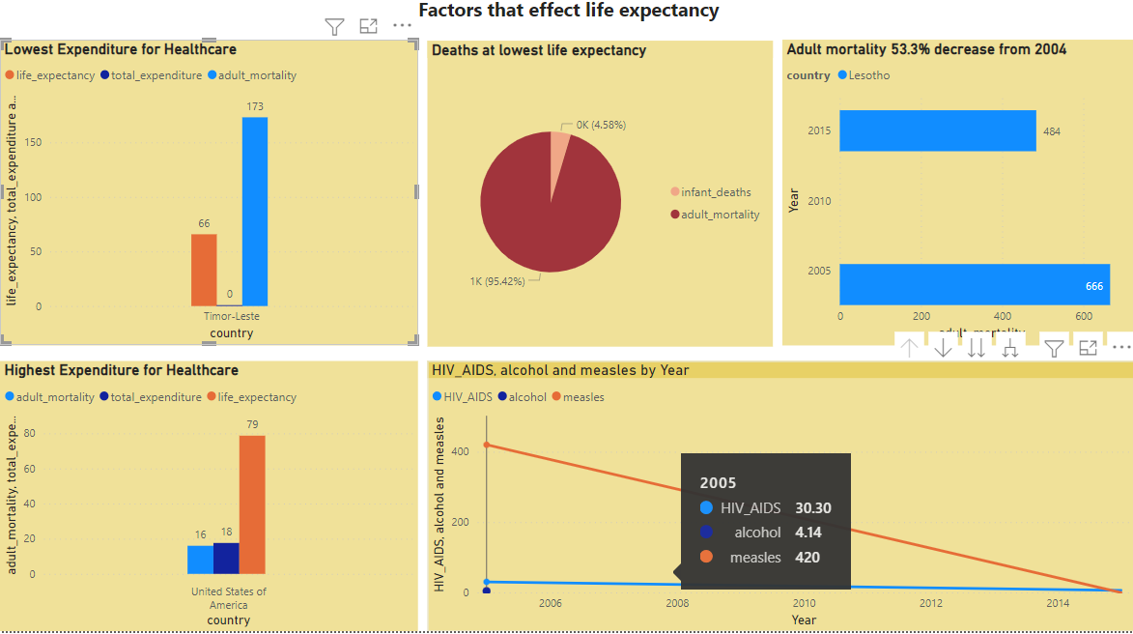
Show us your findings

Slide 7
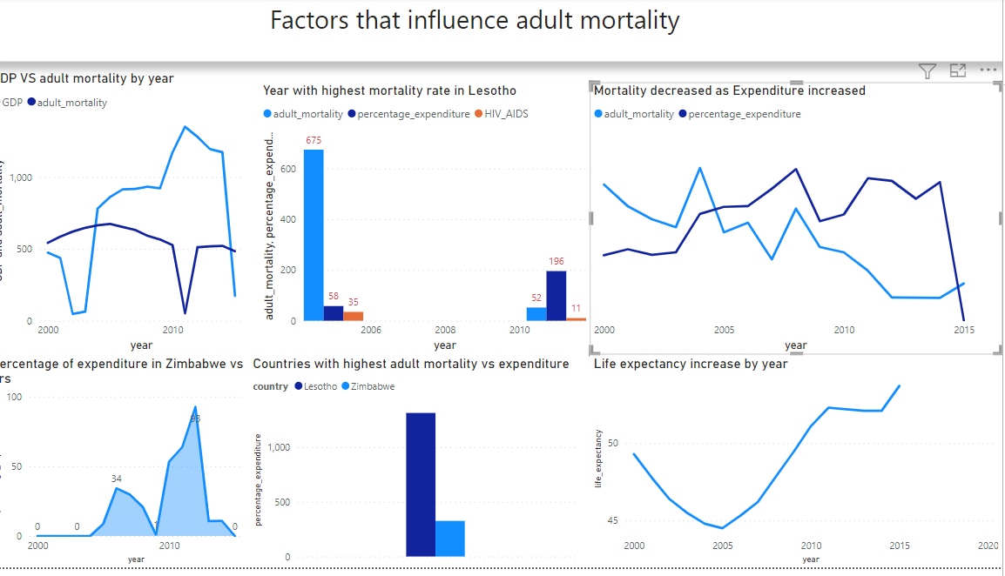

Slide 8
Top 3 Things you have learnt on the bootcamp
Educationally: How to code in Python and SQL as well as using excel to draw out main factors about data. Also the skills of understanding and analysis data and how to draw out important data based of the problem that is required to be solved.
Personally: I have learnt to be more of a critical thinker and pay attention to detail, as this will help overall with performing my best.
Career Wise: I have found a keen interest in becoming a data analysis as I love discovering the reasoning behind situations, or the cause of an issue.

